Slide 1
Sales Tracking Project
By: Ambrim Syed

Slide 2
Introduction
In this project, I will showcase a sales tracking application using the Java programming language, using Netbeans IDE. This project aims to implement my knowledge in advanced OOP techniques and design patterns, mainly focused on iteration, to process sales data efficiently. This application will help with tracking and analyzing sales performance of different salespeople, providing valuable insights of total sales, minimum, maximum, and average sales figures.

Slide 3
Iterator Pattern
Let’s go over the iterator patterns used in my project.
The “SalesPerson” class uses an iterator to manage and traverse sales data efficiently. SalesPerson encapsulates the sales figures in an “ArrayList<Double>” and provides the “iterSales()” method, in which it returns an iterator over this list. It means the iterator enables sequential access to each sales figure without exposing the underlying data structure. Now, with the “MainProgram” class, it can effectively process the sales data for each salesperson. The main program collects sales figures from user input, stores them in “SalesPerson” objects, and uses the iterator to traverse and perform calculations such as total, minimum, maximum, and average sales. This is a good approach because it enhances code modularity and maintainability to ensure that the logic for data traversal is encapsulated within the “SalesPerson” class.

Slide 4
Comparison to OOP, Functional, and Structured Programming
Iterators in this project showcases the principles of object-oriented programming, which emphasizes encapsulation, modularity, and design patterns. Encapsulating sales data and traversal logic within “SalesPerson” class adheres to OOP principles to make it maintainable and scalable. However, with functional programming languages, this approach to the problem would be to focus on immutability and pure functions to process sales data. With structured programming, it’d emphasize clear, linear control structures such as loops and conditionals to traverse and manipulate data, but this would lead to more verbose and less modular code.

Slide 5
SalesPerson Class Code
package salestracking;
import java.util.ArrayList;
import java.util.Iterator;
public class SalesPerson {
private String name;
private String title;
private ArrayList<Double> sales;
//Constructor
public SalesPerson(String name, String title, ArrayList<Double> sales) {
this.name = name;
this.title = title;
this.sales = new ArrayList<>(sales);
}
//Getters and setters
public String getName() {
return name;
}
public void setName(String name) {
this.name = name;
}
public String getTitle() {
return title;
}
public void setTitle(String title) {
this.title = title;
}
public ArrayList<Double> getSales() {
return new ArrayList<>(sales);
}
public void setSales(ArrayList<Double> sales) {
this.sales = new ArrayList<>(sales);
}
//Iterator for sales
public Iterator<Double> iterSales() {
return sales.iterator();
}
//Calculations
public double getTotalSales() {
double total = 0;
for (double sale : sales) {
total += sale;
}
return total;
}
public double getMinSales() {
return sales.stream().min(Double::compare).orElse(0.0);
}
public double getMaxSales() {
return sales.stream().max(Double::compare).orElse(0.0);
}
public double getAverageSales() {
if (sales.isEmpty()) {
return 0.0;
}
return getTotalSales() / sales.size();
}
@Override
public String toString() {
return "Name: " + name + ", Title: " + title + ", Sales: " + sales.toString();
}
}

Slide 6
MainProgram Class Code
package salestracking;
import java.util.ArrayList;
import java.util.Iterator;
import java.util.Scanner;
public class MainProgram {
public static void main(String[] args) {
Scanner scanner = new Scanner(System.in);
ArrayList<SalesPerson> salesPeople = new ArrayList<>();
//Loop collects details for 3 salespeople
for (int i = 0; i < 3; i++) {
System.out.println("Enter details for salesperson " + (i + 1) + ":");
//Collect names of salesperson
System.out.print("Name: ");
String name = scanner.nextLine();
//Collect titles of salesperson
System.out.print("Title: ");
String title = scanner.nextLine();
//Collect 3 sales figures for each salesperson
ArrayList<Double> sales = new ArrayList<>();
System.out.println("Enter at least 3 sales figures (separated by spaces):");
for (int j = 0; j < 3; j++) {
sales.add(scanner.nextDouble());
}
//Consume the newline
scanner.nextLine();
//Create SalesPerson object with the details above
SalesPerson person = new SalesPerson(name, title, sales);
salesPeople.add(person);
}
//Display sales report for each salesperson
System.out.println("\nSales Report:");
double companyTotalSales = 0.0;
for (SalesPerson person : salesPeople) {
System.out.println(person);
System.out.println("Total Sales: " + person.getTotalSales());
System.out.println("Min Sales: " + person.getMinSales());
System.out.println("Max Sales: " + person.getMaxSales());
System.out.println("Average Sales: " + person.getAverageSales());
System.out.println();
//Total sales for entire company accumulated
companyTotalSales += person.getTotalSales();
}
//Print total sales for entire company
System.out.println("Total Sales for the Entire Company: " + companyTotalSales);
scanner.close();
}
}

Slide 7
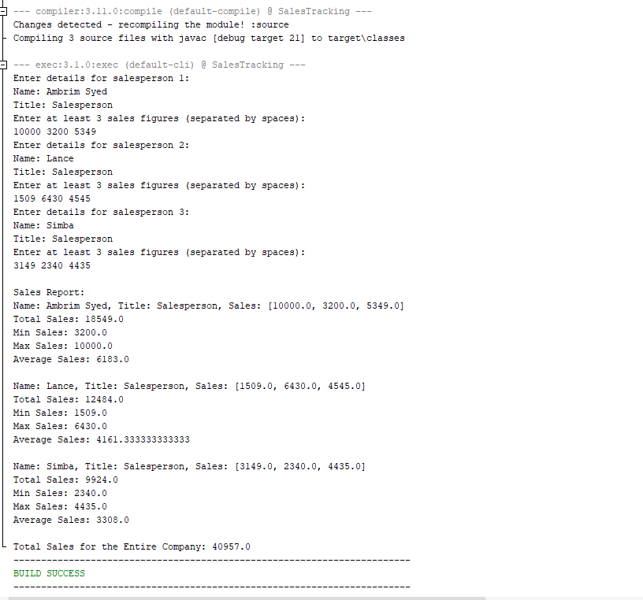
Screenshot of working code

Slide 8
Conclusion + Github Link
I’ve had a great experience with creating this Sales Tracking Project to effectively demonstrate the use of object-oriented programming principles, design patterns in iteration, and managing and processing sales data. This project not only highlights the importance of encapsulation and modularity with software design, but also demonstrates the practical application of iterators in processing and analyzing data. Overall, creating a Sales Tracking project serves as a solid foundation for building more advanced and scalable sales management applications and analysis.
https://github.com/AmbrimSyed/Sales-Tracking-Project

